Slide 1
Topology of Flight Paths
Tobias Soltvedt

Slide 2
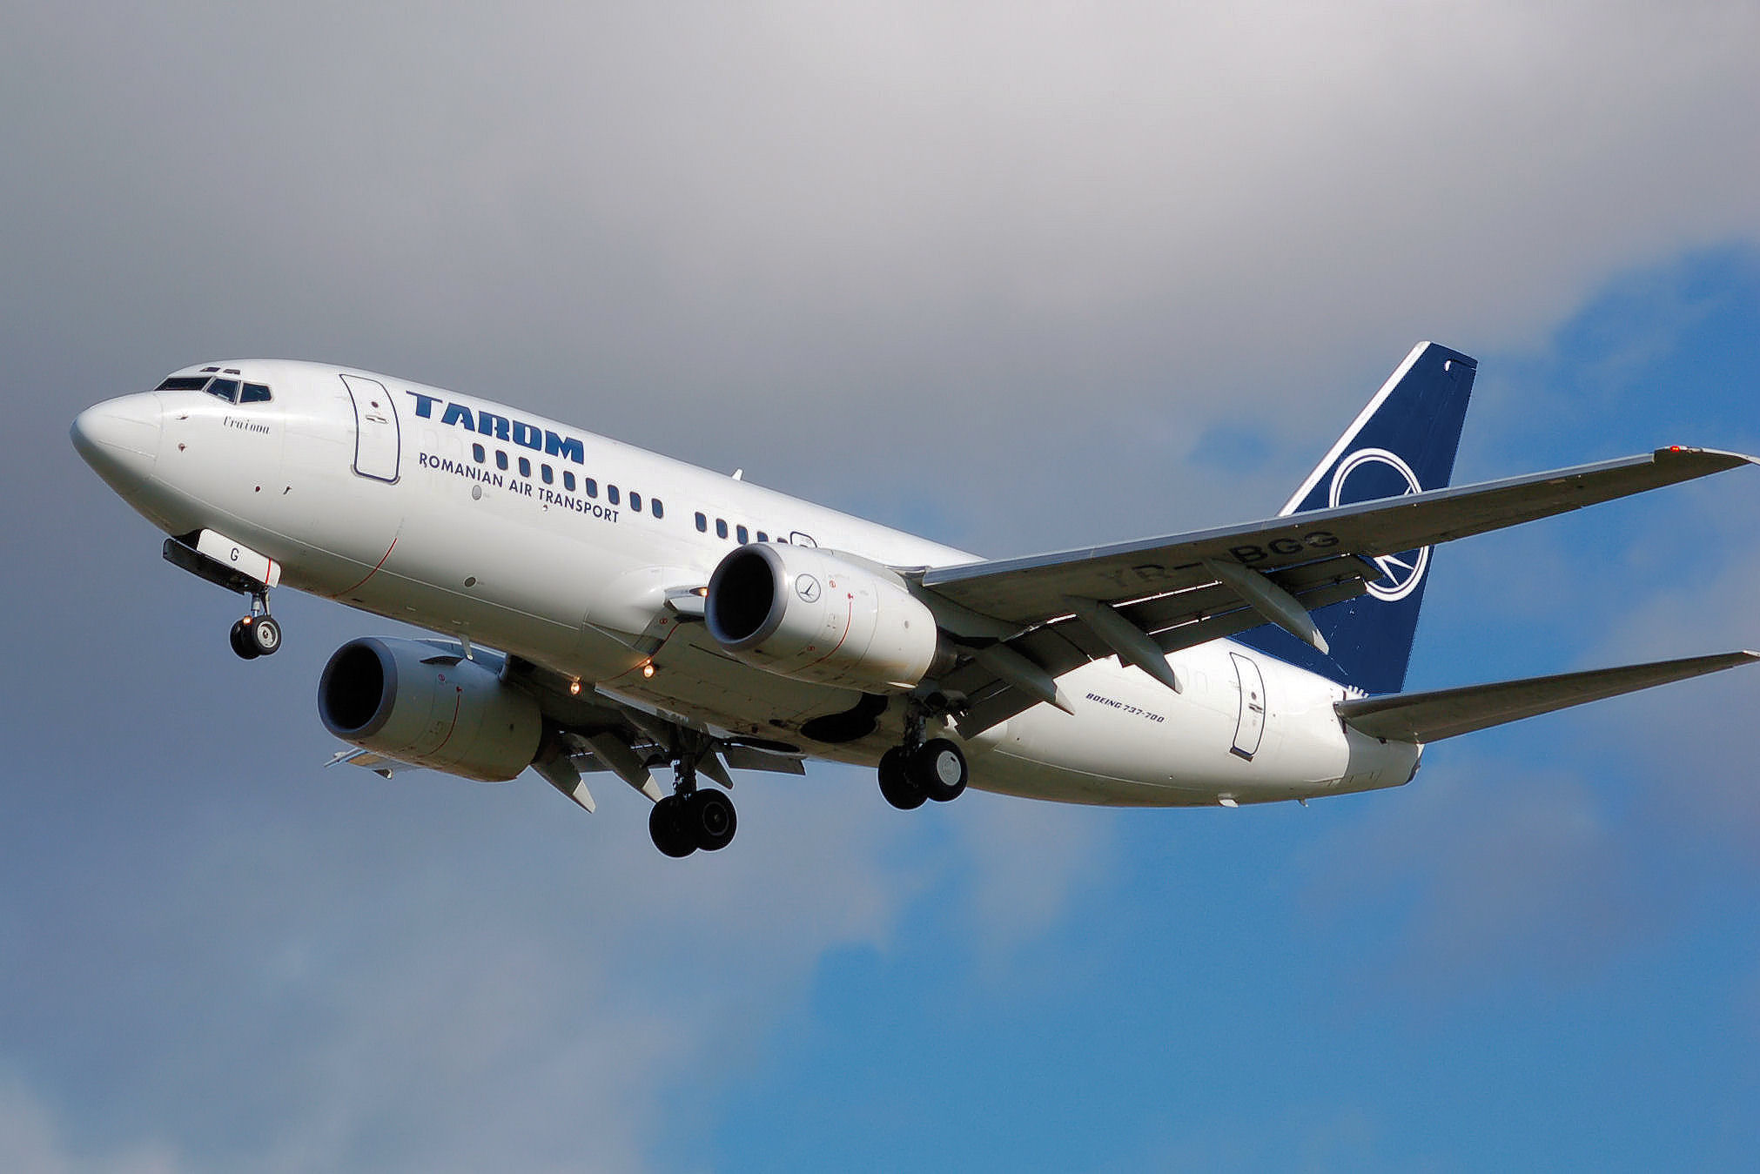
The Problem:
Is it viable to use Topological data analysis (TDA) on flight traffic data?
How will I get the data?
What does the data look like?
What is TDA?
How could I use TDA?

Slide 3
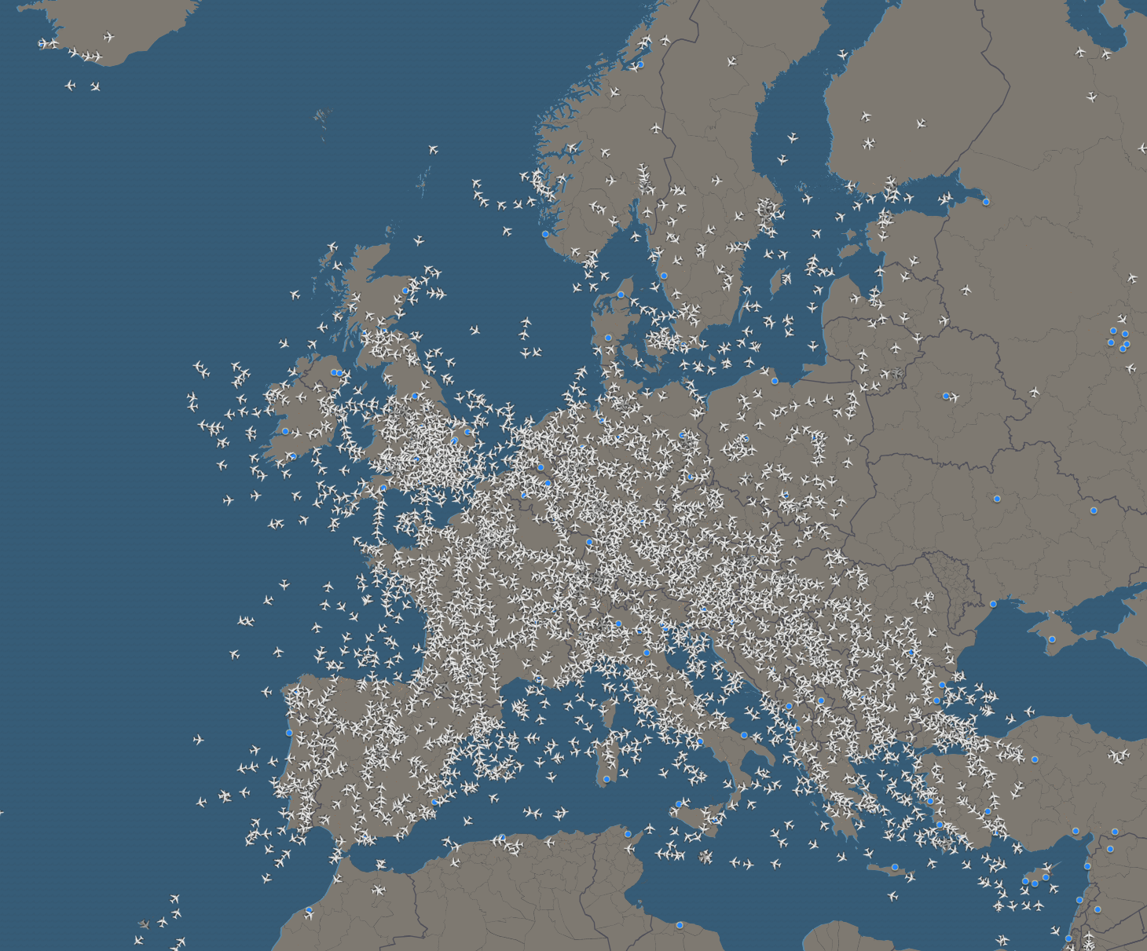
The Data:
Opensky Network
Crowd sourced database
Python libraries:
Query the database for flights
Visualize and manage flight data

Slide 4
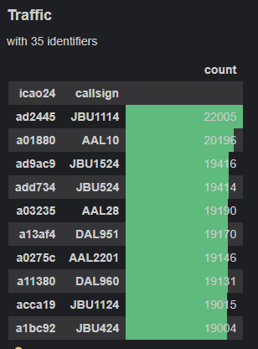
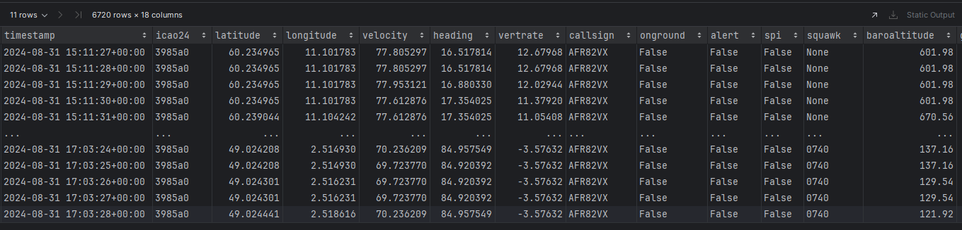
What does the data look like?
2 main objects:
Traffic holds data about many flights
Flight holds data about a single flight

Slide 5
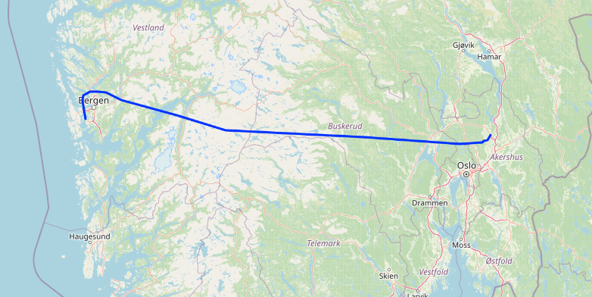
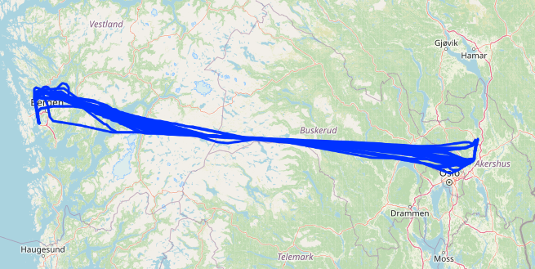
What does the data look like?
A flight from Gardemoen to Flesland the 29th of August
All the flights from Gardermoen to Flesland during the 29th of August

Slide 6
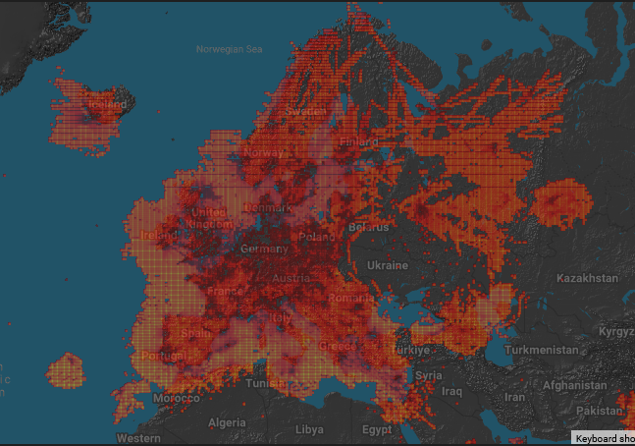
Potential issues:
Collected by airplane radio sensors
Missing data
Coverage map
Conclusion:
Focus on flights within Europe and the US

Slide 7
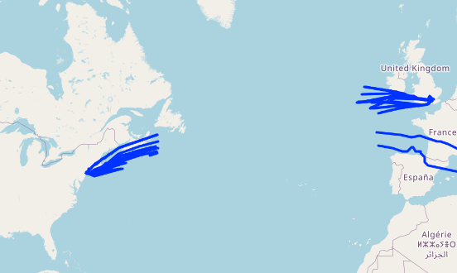
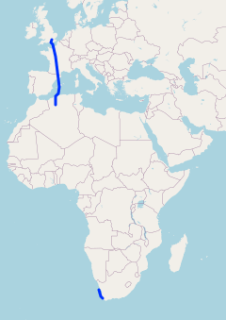
Potential issues:
Missing data over most of Africa
Missing data over the Atlantic ocean
Missing data over Africa

Slide 8
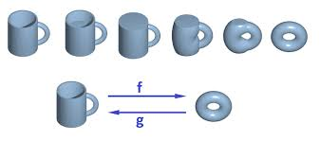
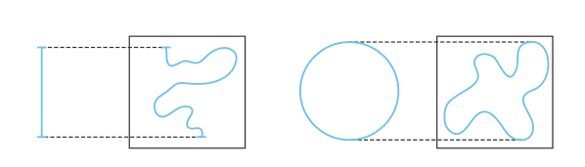
What is Topological data analysis? (TDA)
Related to Geometry
Focuses on shape instead of distances
Deformation is Topologically equivalent

Slide 9
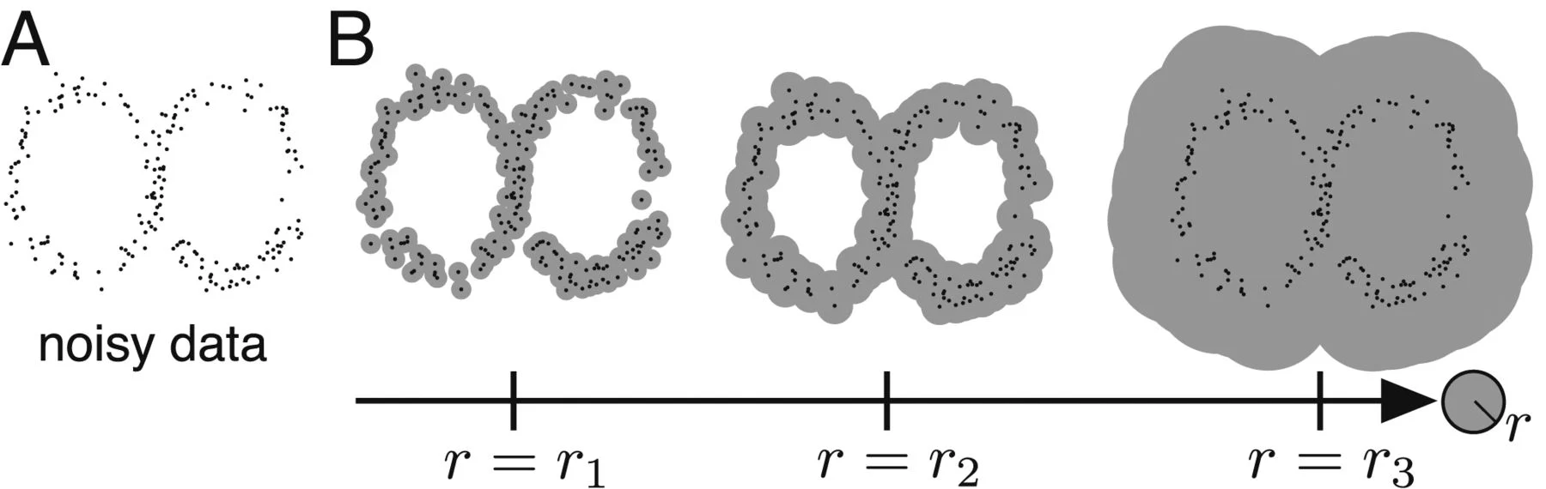
Benefits and Disadvantages:
Good at detecting data shape
Stable to noisy data
TDA is computationally expensive (O(n^3)?)

Slide 10
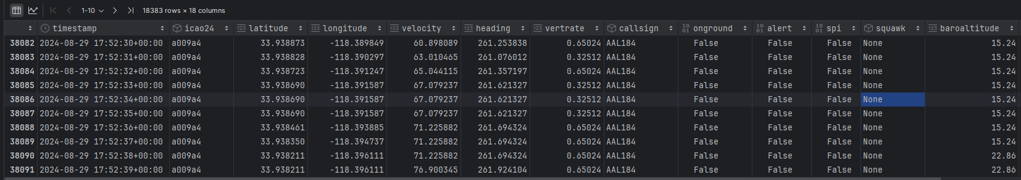
Potential issues:
There is a lot of data
18 300 rows for a single flight
28.000.000 rows in 2023 between Bergen and Oslo
Resampling?

Slide 11
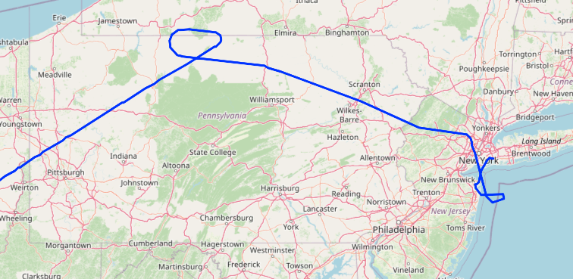
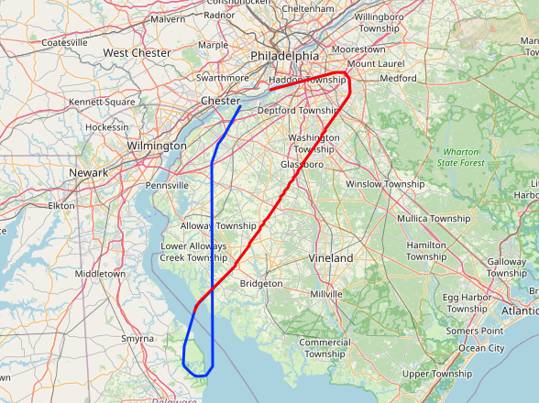
Goal:
No specific goal
Potential goals could be to predict if:
An airport is busy
There has been an emergency

Slide 12
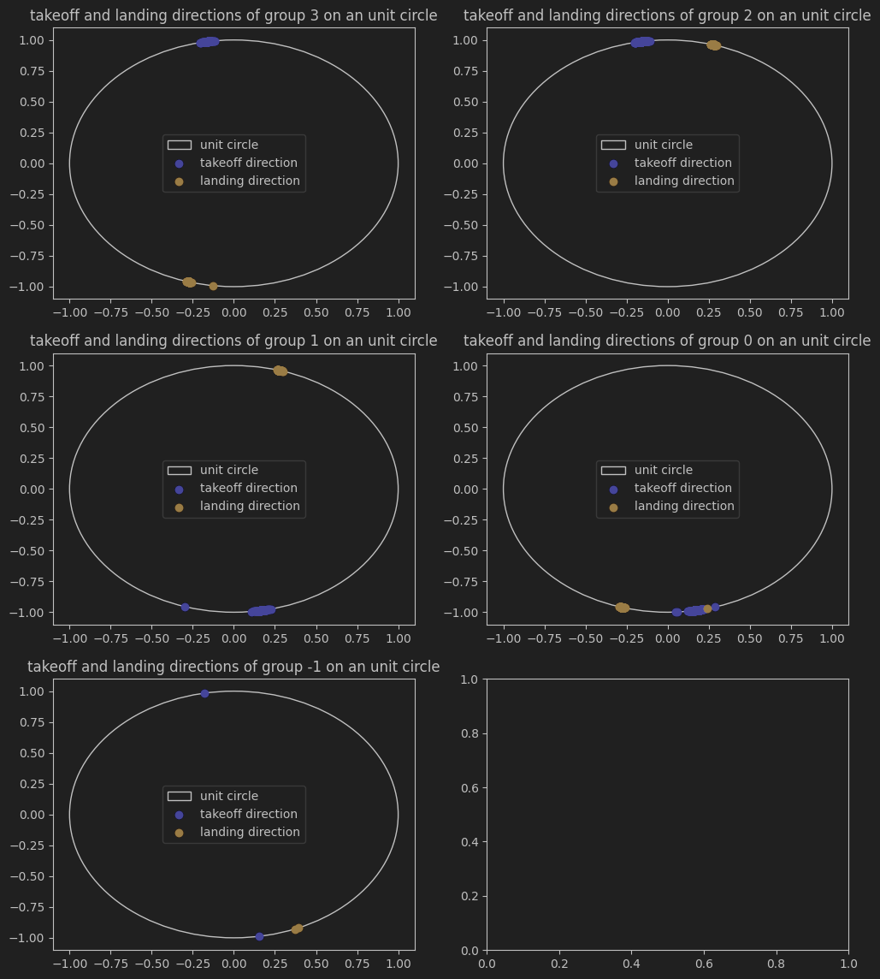
Early experiments:
Mostly just learning about the data
Landing/Takeoff clustering

